Slide 1
Hello.

Slide 2



the Course
Session 1
Grounding -
What is marketing
The Course
Understanding Critical Concepts in marketing
Session 2
Critical Concepts
Needs, wants, Demands
Consumer vs Customer
Marketing Environment
Session 3
Consumer Behavior
Neuroscience
Consumer Buying Behavior – Consumer Bias
Consumer Funnels
Knowing Consumers Better
Session 4
Target Consumer
Segmenting & Targeting
Pen Profiles
Understanding Motivations
Session 5
Consumer Insight
Consumer Insighting

Slide 3
the Course
Session 5
Customer value
Types of Benefits
Differentiation
Positioning
Customer Value
Session 7
Go to Market 1
Elements of GTM
Anchor vs user TG
Parameters of Marketing & Go to Market
Session 8
Go to market 2
Channel & Retail Environment
Platforms
Session 9
Drive Growth & Measuring Success
PITA
Marketing Objectives
Brand Health
Growth, Marketing Objectives & How to measure them
Session 10
Measuring Success
Business health
Digital Funnel & Measurements

Slide 4



Think of a brand you bought recently
What ”want” was it satisfying?
And
What “need” was it satisfying

Slide 5
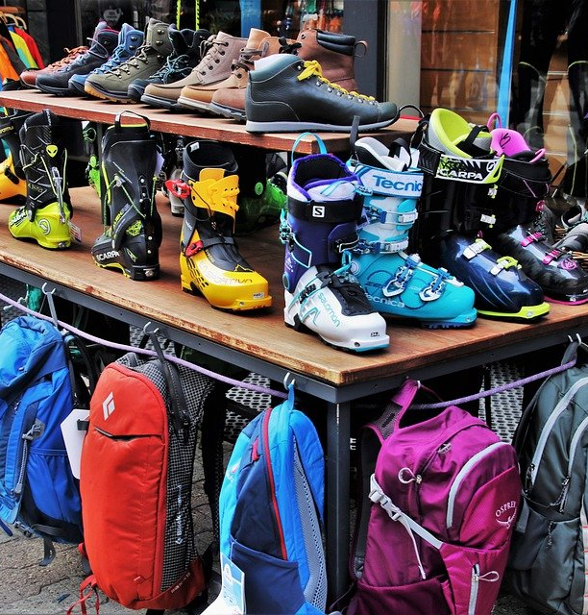
Needs, Wants, Demand
Marketing is about creating, communicating and delivering value to consumers!
Foundation of value lies in understanding needs, wants and demands!
Needs
Basic human requirements
Wants
A specific manner of satisfying needs
Want for specific product, backed by the ability to pay
Demand
Notes:
Needs (basic human requirements)
Definition: States of felt deprivation — what humans require to survive or thrive. Universal & innate: food, water, clothing, shelter, safety, belonging, esteem, self-actualization (Maslow).
Examples:
Need for nourishment - food.
Need for safety - secure housing, reliable locks.
Need for belonging - social connections, community.
E.g., Colgate addresses the need for hygiene and health.
E.g., Uber addresses the need for safe, reliable mobility.
2. Wants (needs shaped by culture & personality)
Definition: The specific form needs take when shaped by culture, society, and individual preferences. Not universal — they differ across cultures, income levels, and lifestyles.
Examples:
Need: food - Want: sushi in Japan, biryani in India, pizza in Italy.
Need: belonging - Want: Instagram likes for Gen Z, family gatherings for older generations.
Need: mobility- Want: driving a Mercedes vs riding a scooter.
E.g., Coca-Cola takes the universal need for hydration and transforms it into the want for happiness & refreshment.
E.g., Starbucks takes the need for caffeine and creates a want for premium café culture.
3. Demands (wants backed by buying power)
Definition: When wants are supported by ability and willingness to pay.
Demand = Want + Purchasing Power
Examples:
Many may want an iPhone; only some can demand it because they can afford it.
A teenager may want a Harley Davidson, but unless they have the resources, it doesn’t become demand.
Luxury spirits convert aspirational wants into actual demand among affluent, urban consumers.
Needs - Universal, basic.
Wants - Needs shaped by culture, identity, marketing influence.
Demands - Wants + ability/willingness to pay.

Slide 6
Needs, Wants, Demand
Wants
Demand
Needs
Wants
Demand
Needs
Food
Pizza
Dominos
Leos
Hygiene
Detergent
Tide
Clothing
Active Wear
Nike
Entertainment
Movie
Netflix
Growth
Career
MBA/Mesa
Facebook
WhatsApp
Connection
Friends

Slide 7
Needs (basic human requirements)
Definition: States of felt deprivation — what humans require to survive or thrive. Universal & innate: food, water, clothing, shelter, safety, belonging, esteem, self-actualization (Maslow).
Examples:
  Need for nourishment - food.
  Need for safety - secure housing, reliable locks.
  Need for belonging - social connections, community.
E.g., Colgate addresses the need for hygiene and health.
E.g., Uber addresses the need for safe, reliable mobility.
2. Wants (needs shaped by culture & personality)
Definition: The specific form needs take when shaped by culture, society, and individual preferences. Not universal — they differ across cultures, income levels, and lifestyles.
Examples:
  Need: food - Want: sushi in Japan, biryani in India, pizza in Italy.
  Need: belonging - Want: Instagram likes for Gen Z, family gatherings for older generations.
  Need: mobility- Want: driving a Mercedes vs riding a scooter.
E.g., Coca-Cola takes the universal need for hydration and transforms it into the want for happiness & refreshment.
E.g., Starbucks takes the need for caffeine and creates a want for premium café culture.
3. Demands (wants backed by buying power)
Definition: When wants are supported by ability and willingness to pay.
Demand = Want + Purchasing Power
Examples:
  Many may want an iPhone; only some can demand it because they can afford it.
  A teenager may want a Harley Davidson, but unless they have the resources, it doesn’t become demand.
  Luxury spirits convert aspirational wants into actual demand among affluent, urban consumers.
Needs - Universal, basic.
Wants - Needs shaped by culture, identity, marketing influence.
Demands - Wants + ability/willingness to pay.

Slide 8
Needs are basic human requirement!. Wants are influenced by
Wants
Needs shaped by culture, personality, reference groups, access to information, life stage, marketing and branding influence,
Demand
Wants backed by buying power
Notes:
While needs are basic human requirements, Wants are influenced by the following
Culture
Societal norms and traditions influence how we satisfy needs. Example: Need = nourishment → Want = millet roti in India, sourdough in Europe, ramen in Japan.
Personality
Individual traits, tastes, and identities. Example: Two people need mobility → one wants a bicycle (fitness-oriented), another wants a sports car (status-driven).
Social Class & Reference Groups
Economic strata and peer influence shape aspiration. Example: Want for clothing → working class may want value-for-money jeans, affluent teens may want Gucci sneakers because of peer circles.
Marketing & Branding Influence
Brands frame and amplify wants by attaching meaning. Example: Need for hydration → Coca-Cola creates a want for happiness and togetherness, not just a cold drink. Example: Need for caffeine → Starbucks creates a want for premium café culture.
Technology & Media Exposure
Exposure to global trends creates new wants. Example: TikTok drives wants for beauty products and viral food trends. Example: Smartphones shifted wants from just communication → to an all-in-one lifestyle device.
Life Stage & Context
Wants evolve as life situations change. Example: Mobility need → child wants a bicycle, young adult wants a scooter, professional wants a car, senior citizen may want a chauffeur-driven ride.
Economic Conditions
Purchasing power shapes how wants are expressed. Example: Need for shelter → in a boom, want = luxury apartment; in downturn, want = affordable rental.
Psychological Drivers
Beyond personality: attitudes, perceptions, learning, motivation (Maslow, Freud, etc.). Example: Need for esteem → want = luxury watch as a status symbol. Example: Need for belonging → want = Instagram likes or joining fandom communities.

Slide 9
While needs are basic human requirements, Wants are influenced by the following
Culture
  Societal norms and traditions influence how we satisfy needs. Example: Need = nourishment → Want = millet roti in India, sourdough in Europe, ramen in Japan.
Personality
  Individual traits, tastes, and identities. Example: Two people need mobility → one wants a bicycle (fitness-oriented), another wants a sports car (status-driven).
Social Class & Reference Groups
  Economic strata and peer influence shape aspiration. Example: Want for clothing → working class may want value-for-money jeans, affluent teens may want Gucci sneakers because of peer circles.
Marketing & Branding Influence
  Brands frame and amplify wants by attaching meaning. Example: Need for hydration → Coca-Cola creates a want for happiness and togetherness, not just a cold drink. Example: Need for caffeine → Starbucks creates a want for premium café culture.
Technology & Media Exposure
  Exposure to global trends creates new wants. Example: TikTok drives wants for beauty products and viral food trends. Example: Smartphones shifted wants from just communication → to an all-in-one lifestyle device.
Life Stage & Context
  Wants evolve as life situations change. Example: Mobility need → child wants a bicycle, young adult wants a scooter, professional wants a car, senior citizen may want a chauffeur-driven ride.
Economic Conditions
  Purchasing power shapes how wants are expressed. Example: Need for shelter → in a boom, want = luxury apartment; in downturn, want = affordable rental.
Psychological Drivers
  Beyond personality: attitudes, perceptions, learning, motivation (Maslow, Freud, etc.). Example: Need for esteem → want = luxury watch as a status symbol. Example: Need for belonging → want = Instagram likes or joining fandom communities.

Slide 10
Exercise 3 – Rapid Fire
Take a piece of paper, keep a pen ready!

Slide 11

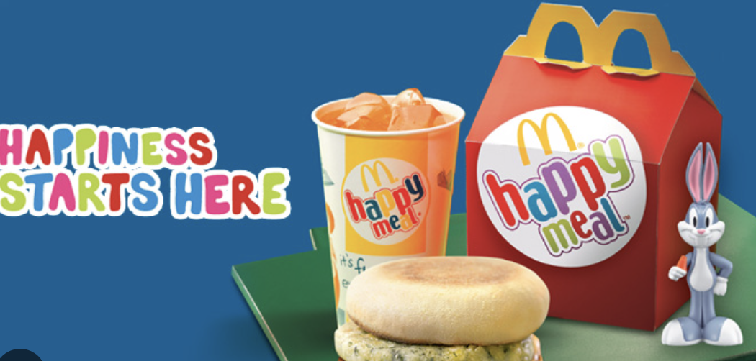
1. Who is the consumer?

Slide 12
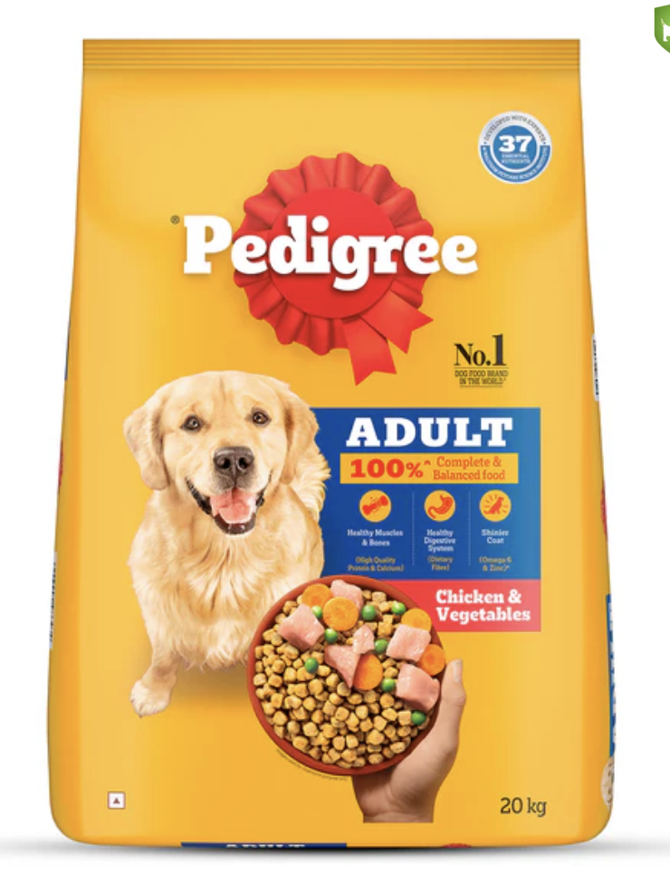
2. Who is the consumer?

Slide 13
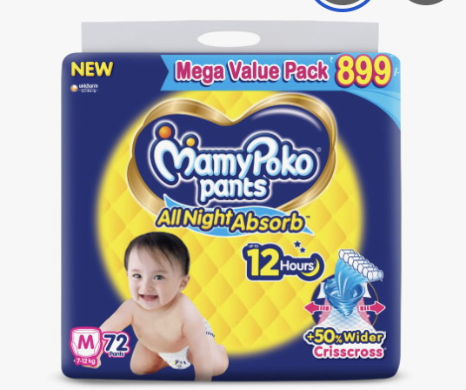
3. Who is the customer?

Slide 14
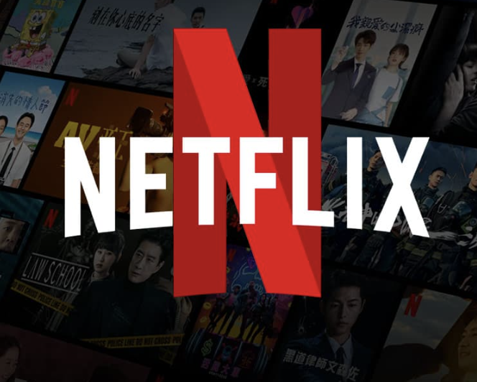
4. Who are the consumers?

Slide 15
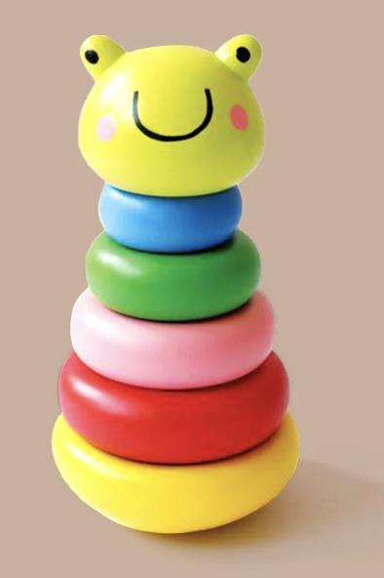
5. Who is the customer?

Slide 16
Consumers are ones to derive satisfaction and drive future demand
Customers are decision makers to pay!
Notes:
Customer vs. Consumer: The Core Difference
Customer = the one who purchases the product or service.
Consumer = the one who actually uses or consumes it.
Sometimes they are the same person (buying a Coke at a vending machine and drinking it yourself). Other times, they are different people (a parent buys a toy → child plays with it).
Examples
Baby Diapers
Customer: Parent (decides brand, pays).
Consumer: Baby (uses the product).
Pet Food
Customer: Pet owner.
Consumer: Dog or cat.
Alcohol & Cigarettes
Usually, customer = consumer.
But in gifting occasions (weddings, corporate gifts), customer ≠ consumer.
Education Services (like MBA coaching)
Customer: Parent (often pays fees).
Consumer: Student (uses the service).
Digital Subscriptions (e.g., Netflix, Spotify)
Customer: The one who pays for the subscription.
Consumer: Everyone in the household who uses it.
Why the Distinction Matters for Marketers
Targeting & Messaging
If customer ≠ consumer, you may need dual messaging.
Example: McDonald’s Happy Meal → toys & fun appeal to children (consumers), but price, nutrition, and safety messaging targets parents (customers).
Packaging & Presentation
Customer focus: Ease of purchase, shelf appeal, trust signals.
Consumer focus: Usability, taste, experience.
Example: Toothpaste → parents buy based on fluoride/safety, kids want fun flavors & characters.
Channel Strategy
Sometimes customer = distributor/retailer (B2B), while consumer = end user.
Example: Colgate must win over dentists/pharmacies (customers) to reach households (consumers).
Brand Loyalty
Customers may be swayed by price/promotions, but consumers build habit and loyalty.
Example: A child may demand Maggi noodles because of taste → parent (customer) complies, even if cheaper alternatives exist.
New Market Opportunities
Understanding both roles can open innovation spaces.
Example: Pampers didn’t just sell diapers; it built parenting advice platforms → deepening the customer relationship.
Customer vs. Consumer in B2B
Customer = the organization (or decision maker within it) that buys the product/service.
Consumer (or end user) = the employee, department, or team that actually uses it day-to-day.
In B2B, often there are multiple stakeholders in the purchase:
Decision maker (C-suite, procurement) - Customer
Influencer (technical experts, managers) - Customer
User (employees, operators, staff) – Consumer/User
Examples
1. SaaS (e.g., Slack, Microsoft Teams)
Customer: CIO, CTO, or procurement team signs the contract.
Consumer: Employees who actually use the software daily.
Industrial Equipment (e.g., Caterpillar Excavators)
Customer: Construction company’s procurement head.
Consumer: Machine operators at the construction site.
Implication:
To customers: Communicate durability, total cost of ownership, after-sales service.
To consumers: Ensure ergonomics, ease of operation, safety features.
If operators dislike it, they’ll complain → company may switch suppliers.
3. Corporate Training Services
Customer: HR head or L&D manager who signs the deal.
Consumer: Employees/managers attending the training.
4. Office Supplies (e.g., Xerox Printers, Stationery)
Customer: Procurement manager.
Consumer: Office staff who print/copy daily.

Slide 17
Customer vs. Consumer: The Core Difference
Customer = the one who purchases the product or service.
Consumer = the one who actually uses or consumes it.
Sometimes they are the same person (buying a Coke at a vending machine and drinking it yourself). Other times, they are different people (a parent buys a toy → child plays with it).
Examples
Baby Diapers
  Customer: Parent (decides brand, pays).
  Consumer: Baby (uses the product).
Pet Food
  Customer: Pet owner.
  Consumer: Dog or cat.
Alcohol & Cigarettes
  Usually, customer = consumer.
  But in gifting occasions (weddings, corporate gifts), customer ≠ consumer.
Education Services (like MBA coaching)
  Customer: Parent (often pays fees).
  Consumer: Student (uses the service).
Digital Subscriptions (e.g., Netflix, Spotify)
  Customer: The one who pays for the subscription.
  Consumer: Everyone in the household who uses it.
Why the Distinction Matters for Marketers
Targeting & Messaging
  If customer ≠ consumer, you may need dual messaging.
  Example: McDonald’s Happy Meal → toys & fun appeal to children (consumers), but price, nutrition, and safety messaging targets parents (customers).
Packaging & Presentation
  Customer focus: Ease of purchase, shelf appeal, trust signals.
  Consumer focus: Usability, taste, experience.
  Example: Toothpaste → parents buy based on fluoride/safety, kids want fun flavors & characters.
Channel Strategy
  Sometimes customer = distributor/retailer (B2B), while consumer = end user.
  Example: Colgate must win over dentists/pharmacies (customers) to reach households (consumers).
Brand Loyalty
  Customers may be swayed by price/promotions, but consumers build habit and loyalty.
  Example: A child may demand Maggi noodles because of taste → parent (customer) complies, even if cheaper alternatives exist.
New Market Opportunities
  Understanding both roles can open innovation spaces.
  Example: Pampers didn’t just sell diapers; it built parenting advice platforms → deepening the customer relationship.

Slide 18
Customer vs. Consumer in B2B
Customer = the organization (or decision maker within it) that buys the product/service.
Consumer (or end user) = the employee, department, or team that actually uses it day-to-day.
In B2B, often there are multiple stakeholders in the purchase:
Decision maker (C-suite, procurement) - Customer
Influencer (technical experts, managers) - Customer
User (employees, operators, staff) – Consumer/User
Examples
1. SaaS (e.g., Slack, Microsoft Teams)
Customer: CIO, CTO, or procurement team signs the contract.
Consumer: Employees who actually use the software daily.
Industrial Equipment (e.g., Caterpillar Excavators)
Customer: Construction company’s procurement head.
Consumer: Machine operators at the construction site.
Implication:
  To customers: Communicate durability, total cost of ownership, after-sales service.
  To consumers: Ensure ergonomics, ease of operation, safety features.
If operators dislike it, they’ll complain → company may switch suppliers.
3. Corporate Training Services
Customer: HR head or L&D manager who signs the deal.
Consumer: Employees/managers attending the training.
4. Office Supplies (e.g., Xerox Printers, Stationery)
Customer: Procurement manager.
Consumer: Office staff who print/copy daily.

Slide 19
Marketing Environment
Marketing is dependent on the type of Markets…..
Sellers Market
Production Orientation
Buyers Market
Marketing Orientation
Connected Community
Experience Orientation
Economic Uncertainty
Trust Orientation

Slide 20
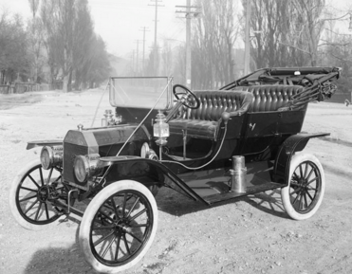
Types of Markets
Sellers' Market: Production Orientation
Seller has all the powers and consumer will go to the seller to buy the product
“Better Mouse Trap”- Focus is on high quality product with little or no focus on what the customer wants….
Inside Out Marketing
Objective – Sell as much as you can….market shares!
Resultant increase in volumes, reduced cost and increased profitability
“Any Customer can have a car painted any color that he wants, so long as it is black” - One of Henry Ford's famous quotes about the Model T
Notes:
Global Context
Stage 1: Production / Seller’s Market (early 1900s – 1930s,)
Context: Demand far outstripped supply. Industrialization enabled mass production. Distribution was limited, competition was low.
Philosophy: “Good product at scale will sell itself.”
Seller’s Power: Seller dictated terms (product features, price, availability).
Marketing Focus:
Efficiency of production
Reducing cost per unit
Limited product variation
Classic Quote: Henry Ford — “Any customer can have a car painted any color… so long as it is black.”
Examples:
Ford Model T (1908) – mass production, affordability.
Early Coca-Cola – one formula, one package.
Singer Sewing Machines – selling efficiency, not customization.
India Context: Pre 1991 ( liberalisation) was a scarcity and sellers market
Post-independence economy was license-permit-quota raj.
Production capacity was limited, imports restricted, competition low.
Demand consistently outstripped supply in most categories.
Philosophy: “If you can make it, people will buy it.”
Seller’s Power: Companies and PSUs dictated choices; consumers had few alternatives.
Marketing Focus:
Distribution reach (availability mattered more than persuasion).
Efficiency of production.
Low product variety, high standardization.
Examples:
Ambassador Car (Hindustan Motors): Dominated Indian roads for decades with virtually no competition. Consumers waited years for delivery.
Bajaj Chetak scooter: “Hamara Bajaj” came later, but in early days, families booked scooters and waited 5–10 years.
LIC: As the sole life insurer, marketing was almost non-existent; presence was enough.
HMT watches: Scarcity ensured demand, with limited models and standard designs.
I

Slide 21
Global Context
Stage 1: Production / Seller’s Market (early 1900s – 1930s,)
Context: Demand far outstripped supply. Industrialization enabled mass production. Distribution was limited, competition was low.
Philosophy: “Good product at scale will sell itself.”
Seller’s Power: Seller dictated terms (product features, price, availability).
Marketing Focus:
  Efficiency of production
  Reducing cost per unit
  Limited product variation
  Classic Quote: Henry Ford — “Any customer can have a car painted any color… so long as it is black.”
Examples:
  Ford Model T (1908) – mass production, affordability.
  Early Coca-Cola – one formula, one package.
  Singer Sewing Machines – selling efficiency, not customization.
India Context: Pre 1991 ( liberalisation) was a scarcity and sellers market
  Post-independence economy was license-permit-quota raj.
  Production capacity was limited, imports restricted, competition low.
  Demand consistently outstripped supply in most categories.
Philosophy: “If you can make it, people will buy it.”
Seller’s Power: Companies and PSUs dictated choices; consumers had few alternatives.
Marketing Focus:
  Distribution reach (availability mattered more than persuasion).
  Efficiency of production.
  Low product variety, high standardization.
Examples:
  Ambassador Car (Hindustan Motors): Dominated Indian roads for decades with virtually no competition. Consumers waited years for delivery.
  Bajaj Chetak scooter: “Hamara Bajaj” came later, but in early days, families booked scooters and waited 5–10 years.
  LIC: As the sole life insurer, marketing was almost non-existent; presence was enough.
  HMT watches: Scarcity ensured demand, with limited models and standard designs.
I

Slide 22
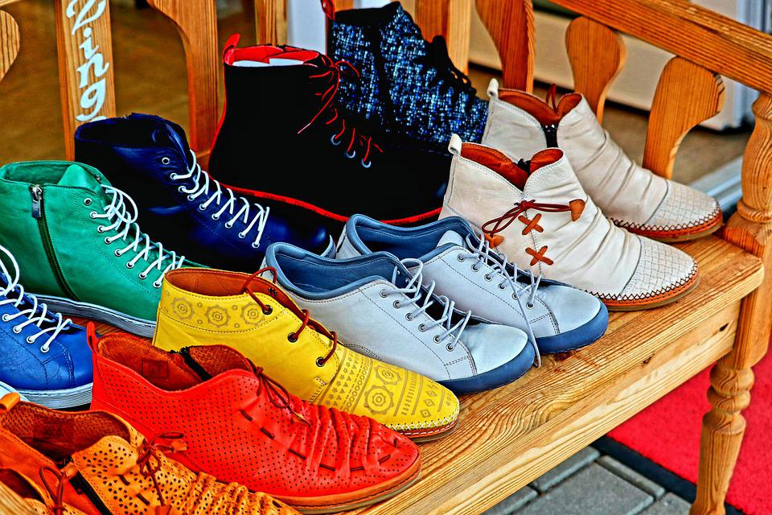
Types of Markets
Buyers' Market: Marketing Orientation
Focus on what the customer wants and deliver a product that meets the same.
Because you are focusing on customer wants….you have to segment & target
Outside In….
Objective – Deliver Customer Value and profitability through premium pricing, Customer Loyalty and Cross Sell
“Can I buy shoes of different sizes?”
Notes:
Stage 2: Marketing Orientation (1960s–1990s globally, 1990s–2000s in India)
Context:
Competition increased. Supply began to catch up with demand.
Consumers had more choice → companies needed to differentiate.
Market research, segmentation, and branding took root.
Philosophy: “Find out what the customer wants, then produce it.”
Consumer Power: Shift from seller power → consumer preference.
Marketing Focus:
Segmentation, Targeting, Positioning (STP framework emerged).
Building brands as carriers of value.
Driving premium pricing through perceived value (not just cost efficiency).
Examples (Global):
P&G pioneered brand management — different detergents for different segments.
Pepsi vs. Coke “taste wars” → consumer choice defined competition.
Nike built brand equity around “Just Do It” vs. just selling shoes.
Indian Context
For India, this shift became visible post-1991 Liberalization, when supply expanded and global brands entered:
Segmentation & Targeting arrive:
Surf vs. Nirma: HUL (premium, urban) vs. Nirma (value, mass) - clear segmentation.
Cola Wars (Coke vs. Pepsi, 1990s): Targeting youth with different brand personalities.
Premium pricing based on value:
Maruti Suzuki broke Ambassador/Fiat monopoly - cars for segments (800 for middle class, Esteem for aspirational).
Shampoos in sachets (HUL, CavinKare) → segmentation by affordability.
Consumer Research: Companies invested in understanding lifestyles, aspirations, and built propositions accordingly.

Slide 23
Global Context
Stage 1: Production / Seller’s Market (early 1900s – 1930s,)
Context: Demand far outstripped supply. Industrialization enabled mass production. Distribution was limited, competition was low.
Philosophy: “Good product at scale will sell itself.”
Seller’s Power: Seller dictated terms (product features, price, availability).
Marketing Focus:
  Efficiency of production
  Reducing cost per unit
  Limited product variation
  Classic Quote: Henry Ford — “Any customer can have a car painted any color… so long as it is black.”
Examples:
  Ford Model T (1908) – mass production, affordability.
  Early Coca-Cola – one formula, one package.
  Singer Sewing Machines – selling efficiency, not customization.
India Context: Pre 1991 ( liberalisation) was a scarcity and sellers market
  Post-independence economy was license-permit-quota raj.
  Production capacity was limited, imports restricted, competition low.
  Demand consistently outstripped supply in most categories.
Philosophy: “If you can make it, people will buy it.”
Seller’s Power: Companies and PSUs dictated choices; consumers had few alternatives.
Marketing Focus:
  Distribution reach (availability mattered more than persuasion).
  Efficiency of production.
  Low product variety, high standardization.
Examples:
  Ambassador Car (Hindustan Motors): Dominated Indian roads for decades with virtually no competition. Consumers waited years for delivery.
  Bajaj Chetak scooter: “Hamara Bajaj” came later, but in early days, families booked scooters and waited 5–10 years.
  LIC: As the sole life insurer, marketing was almost non-existent; presence was enough.
  HMT watches: Scarcity ensured demand, with limited models and standard designs.
I

Slide 24
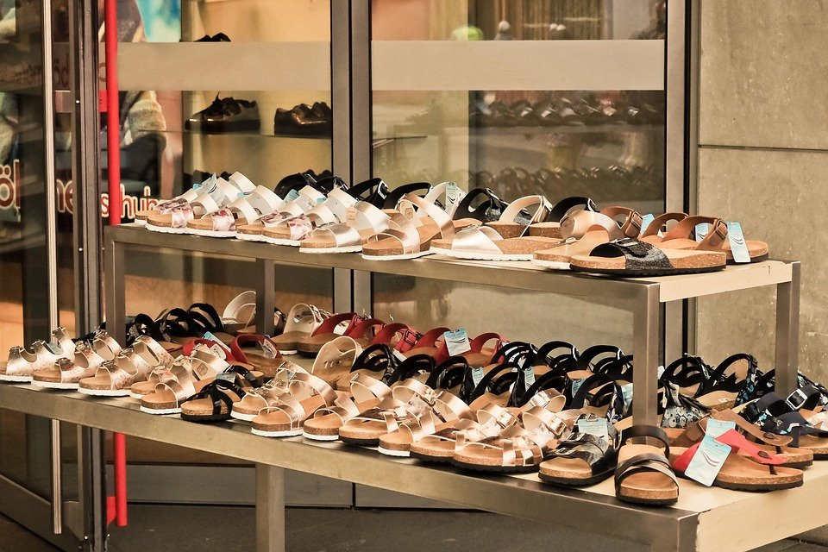
Types of Markets : Experience Orientation
Not just the product….but the whole experience that one goes through in buying or consuming the same.
Deliver not only value… but a top-notch customer experience
“You can only exchange against change in size , but can't change the pattern”
Notes:
Stage 3: Experience Orientation (2000s onwards)
Context:
Products became commoditized; competitors could easily match quality and price.
Consumers started seeking differentiation through experiences.
Lifestyle and identity expression became central to consumption.
Philosophy: “Consumers don’t buy products, they buy experiences.”
Consumer Power: Experience and emotion drive loyalty more than function.
Marketing Focus:
Holistic brand experience across touchpoints.
Multi-sensory cues (design, packaging, retail environment).
Service + storytelling + community as part of the value proposition.
Examples (Global):
Starbucks: Selling “the third place” experience, not just coffee.
Apple: Flagship stores as temples of design and innovation.
Nike Run Clubs: Making the brand experience participatory.
Indian Context
Retail & Consumption Experience:
Tanishq: Jewellery buying transformed from a transactional act to an indulgent, trusted, design-rich experience.
Big Bazaar (early 2000s): Pioneered modern retail as an outing for families, not just shopping.
Hospitality & Dining:
Cafe Coffee Day: Created youth hangout culture → coffee as an experience, not beverage.
Fine-dine restaurants & microbreweries: Selling atmosphere, discovery, and togetherness.
Technology & Telecom:
Airtel & Jio: Not just network, but entertainment ecosystems (music, OTT, payments).

Slide 25
Global Context
Stage 1: Production / Seller’s Market (early 1900s – 1930s,)
Context: Demand far outstripped supply. Industrialization enabled mass production. Distribution was limited, competition was low.
Philosophy: “Good product at scale will sell itself.”
Seller’s Power: Seller dictated terms (product features, price, availability).
Marketing Focus:
  Efficiency of production
  Reducing cost per unit
  Limited product variation
  Classic Quote: Henry Ford — “Any customer can have a car painted any color… so long as it is black.”
Examples:
  Ford Model T (1908) – mass production, affordability.
  Early Coca-Cola – one formula, one package.
  Singer Sewing Machines – selling efficiency, not customization.
India Context: Pre 1991 ( liberalisation) was a scarcity and sellers market
  Post-independence economy was license-permit-quota raj.
  Production capacity was limited, imports restricted, competition low.
  Demand consistently outstripped supply in most categories.
Philosophy: “If you can make it, people will buy it.”
Seller’s Power: Companies and PSUs dictated choices; consumers had few alternatives.
Marketing Focus:
  Distribution reach (availability mattered more than persuasion).
  Efficiency of production.
  Low product variety, high standardization.
Examples:
  Ambassador Car (Hindustan Motors): Dominated Indian roads for decades with virtually no competition. Consumers waited years for delivery.
  Bajaj Chetak scooter: “Hamara Bajaj” came later, but in early days, families booked scooters and waited 5–10 years.
  LIC: As the sole life insurer, marketing was almost non-existent; presence was enough.
  HMT watches: Scarcity ensured demand, with limited models and standard designs.
I

Slide 26
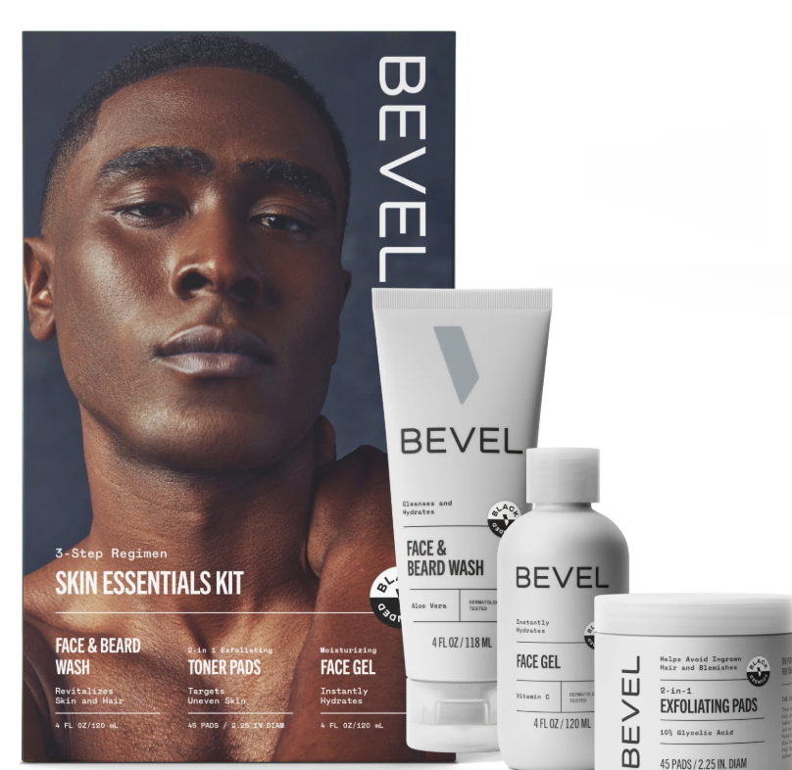
Types of Markets : Connected Community
Brands no longer own the narrative, they co-create with consumers – ”Consumer are not just buyers, but are creators and critics”
Emergence of creators and communities
Segmentation goes deeper – Tribes, microsegments, identity groups, etc.
Notes:
Stage 4: Community Orientation (2010s onwards)
Context:
Digital + social media gave consumers a voice and a platform.
Trust shifted from brands → peers, creators, and communities.
Brands no longer “own the narrative” — they co-create it with consumers.
Philosophy: “Consumers aren’t just buyers, they are participants, creators, and critics.”
Consumer Power:
Communities can build or break brands overnight.
Word of mouth + digital tribes+ influencers.
Marketing Focus:
Building belonging is a added metric in brand equity.
Segmentation goes deeper: tribes, micro-segments, identity groups.
Accountability: authenticity, ethics, transparency demanded.
Examples (Global)
LEGO Ideas: Fans design and vote for new sets - true co-creation.
Glossier: Built its brand by listening to its online beauty community.
Patagonia: Community of environmental activists - brand as a movement.
Examples (India)
boAt: D2C brand fueled by online community of young, music-obsessed consumers; influencer-driven growth.
Perfora, mCaffeine, Sugar Cosmetics: Built communities on Instagram, leveraging UGC and micro-creators.
Zomato: Foodie community → ratings/reviews drive perception more than ads.
Royal Enfield: Long before digital, built biking clubs and “ride communities” - now amplified online.

Slide 27
Global Context
Stage 1: Production / Seller’s Market (early 1900s – 1930s,)
Context: Demand far outstripped supply. Industrialization enabled mass production. Distribution was limited, competition was low.
Philosophy: “Good product at scale will sell itself.”
Seller’s Power: Seller dictated terms (product features, price, availability).
Marketing Focus:
  Efficiency of production
  Reducing cost per unit
  Limited product variation
  Classic Quote: Henry Ford — “Any customer can have a car painted any color… so long as it is black.”
Examples:
  Ford Model T (1908) – mass production, affordability.
  Early Coca-Cola – one formula, one package.
  Singer Sewing Machines – selling efficiency, not customization.
India Context: Pre 1991 ( liberalisation) was a scarcity and sellers market
  Post-independence economy was license-permit-quota raj.
  Production capacity was limited, imports restricted, competition low.
  Demand consistently outstripped supply in most categories.
Philosophy: “If you can make it, people will buy it.”
Seller’s Power: Companies and PSUs dictated choices; consumers had few alternatives.
Marketing Focus:
  Distribution reach (availability mattered more than persuasion).
  Efficiency of production.
  Low product variety, high standardization.
Examples:
  Ambassador Car (Hindustan Motors): Dominated Indian roads for decades with virtually no competition. Consumers waited years for delivery.
  Bajaj Chetak scooter: “Hamara Bajaj” came later, but in early days, families booked scooters and waited 5–10 years.
  LIC: As the sole life insurer, marketing was almost non-existent; presence was enough.
  HMT watches: Scarcity ensured demand, with limited models and standard designs.
I

Slide 28
Types of Markets: Snapshot
Sellers Market
Buyers Market
Experience Market
Community Market
Production Orientation
Marketing Orientation
Experience Orientation
Belonging Orientation
Persuade customer to want what the firm has
Persuade firm to offer what the customer wants
Manage customer’s entire experience with the firm
Consumers are Critics and Creators
Generic Products
Differentiated Products / Services
Personalisation Value
Experiential Value
Competitive Advantage
Lowest Cost
Quality & Service
Customer Knowledge
More than product
Belonging
Profitability Drivers
Market Share
Customer Share
Customer Loyalty
Service & Experience
WOM
Hyper segmentation
Notes:
Useful link to understand the changes in environment ( This link may use different names, but the gist broadly is the same will further help you understand the evolution)
https://www.youtube.com/watch?v=X1VRAiWn6R4&t=13s
https://www.brafton.com/blog/content-marketing/evolution-of-marketing/?utm_source=chatgpt.com

Slide 29
Useful link to understand the changes in environment ( This link may use different names, but the gist broadly is the same will further help you understand the evolution)
https://www.youtube.com/watch?v=X1VRAiWn6R4&t=13s
https://www.brafton.com/blog/content-marketing/evolution-of-marketing/?utm_source=chatgpt.com

Slide 30
Exercise 4 – What happens next
Write a 3 para note on the next phase of marketing environment and its implications
Post for Everyone to See ( before next session)

Slide 31
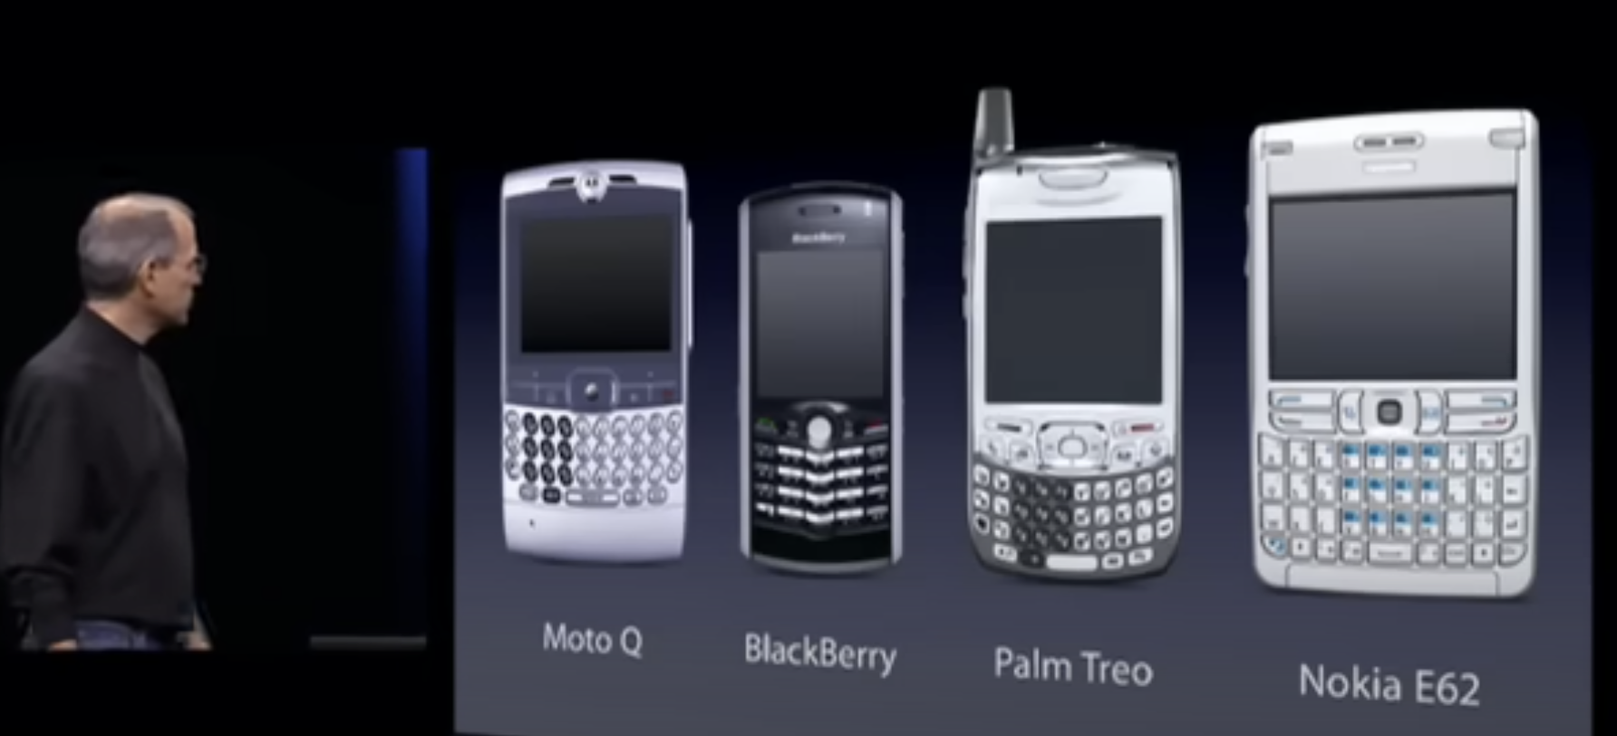
2007, Nokia, Samsung, Blackberry, Motorola, Ericsson & LG held 90% of the Industry profits!
Notes:
USEFUL VIDEO – Steve job Launch of the Apple I phone- https://www.youtube.com/watch?v=MnrJzXM7a6o
Good movie to Watch – Blackberry

Slide 32
Traditional Value Chains - Products
Traditional
Pipeline
Ownership/
Outsourced
Data
Product Dev
Owned
Full
Production
Owned/Outsourced
Full
Primary Distribution
Predominantly Outsourced
Full
Secondary Distribution
Outsourced
( Middle-Men)
Partly Owned
Retailer
Outsourced (Retailers)
No data
Consumer
Partly Owned ( Acquisition. Retention, Loyalty)
No data
Notes:
Notes on Slide 28

Slide 33





Business -Value chains are getting upended…
Traditional
Pipeline
Platforms
Product Dev
Producers
Consumers
Production
Primary Distribution
Providers
Secondary Distribution
Owner
Retailer
Consumer
Notes:
Notes on Slide 28

Slide 34
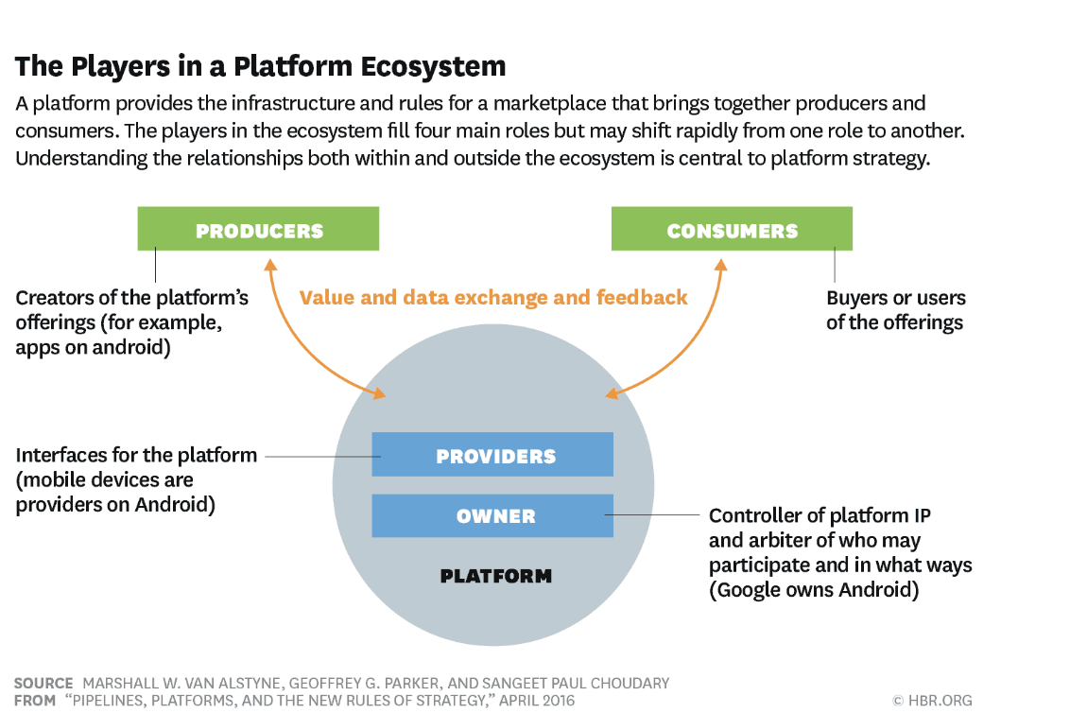
Notes:
Notes on Slide 28

Slide 35

Platforms!
Traditional
Pipeline
Ownership/
Outsourced
Data
Product Dev
Outsourced
Full
Production
Outsourced
Full
Primary Distribution
Owned
Full
Secondary Distribution
Owned
Full
Retailer
Owned
Full
Consumer
Owned/Partly Owned
Full
Notes:
Notes.
A pipeline business has a linear value chain whereas the platform business is a network company that creates a digital/physical space where producer and consumers interact and create value. Pipleline own and or control means of production, whereas platform owns and or operates the network.
Key Differences between Pipelines vs Platform
Resource control to Resource Optimization
Traditional businesses own and control key resources (factories, IP, supply chains, inventory). Platforms don’t need to own most resources. They focus on optimising access to resources owned by others. They create systems where external participants contribute and consume, with the platform orchestrating and reducing friction.
Traditional business competitive advantage comes from exclusive access and control of those resources. Growth is attained by scaling these owned resources. Growth in platform comes from scaling participation and interactions.
Example or Pipeline refinery controls oil fields. Or A hotel chain controls rooms and properties.
Example for Platform – Air Bnb does not own rooms, it optimises access to to millions of host rooms
Internal optimization to External Interaction
Pipeline business drives value by bringing in efficiencies of internal process like manufacturing, logistics, inventory management, etc. Its about how to we make what we own better, faster and cheaper
Platform business focus on quality and quantity of interactions between external participants. They are always looking to onboard more participants, reduce friction in exchanges and incentivize engagement
Customer value to Ecosystem value
Pipeline is looking to deliver value to end consumer/customer through the linear chain
Platforms are built around enabling value creation across the ecosystem – producers, consumer, developers, partners, advertisers)
Key Drivers of Platform
Network effects – Community☺ - E.g Facebook. Get more Engagemen3.
Access and Governance/ Rules and Architecture ( Open Architecture vs Closed Architecture – E.g – Uber and appler from Super pumped
Reduce friction of exchanges – Strong feedback loops.
IMPORTANT READ - HRB Article - Pipelines, platforms and new rules of strategy by Marshall W Van Alynstne, Geoffrey Parker and Sangeet Paul Chaudhary
Good Book to Read – Hamilton Helmer 7 Powers

Slide 36
Notes.
A pipeline business has a linear value chain whereas the platform business is a network company that creates a digital/physical space where producer and consumers interact and create value. Pipleline own and or control means of production, whereas platform owns and or operates the network.
Key Differences between Pipelines vs Platform
Resource control to Resource Optimization
  Traditional businesses own and control key resources (factories, IP, supply chains, inventory). Platforms don’t need to own most resources. They focus on optimising access to resources owned by others. They create systems where external participants contribute and consume, with the platform orchestrating and reducing friction.
  Traditional business competitive advantage comes from exclusive access and control of those resources. Growth is attained by scaling these owned resources. Growth in platform comes from scaling participation and interactions.
    Example or Pipeline refinery controls oil fields. Or A hotel chain controls rooms and properties.
    Example for Platform – Air Bnb does not own rooms, it optimises access to to millions of host rooms
Internal optimization to External Interaction
  Pipeline business drives value by bringing in efficiencies of internal process like manufacturing, logistics, inventory management, etc. Its about how to we make what we own better, faster and cheaper
  Platform business focus on quality and quantity of interactions between external participants. They are always looking to onboard more participants, reduce friction in exchanges and incentivize engagement
Customer value to Ecosystem value
  Pipeline is looking to deliver value to end consumer/customer through the linear chain
  Platforms are built around enabling value creation across the ecosystem – producers, consumer, developers, partners, advertisers)
Key Drivers of Platform
Network effects – Community☺ - E.g Facebook. Get more Engagemen3.
Access and Governance/ Rules and Architecture ( Open Architecture vs Closed Architecture – E.g – Uber and appler from Super pumped
Reduce friction of exchanges – Strong feedback loops.
IMPORTANT READ - HRB Article - Pipelines, platforms and new rules of strategy by Marshall W Van Alynstne, Geoffrey Parker and Sangeet Paul Chaudhary
Good Book to Read – Hamilton Helmer 7 Powers

Slide 37
Exercise 2 – Work in Groups, be ready to Share!
Use this framework, List down Needs, wants and Demands of Aaditya & Shaniram

Slide 38
Prep For Next Session
Read up on Cognitive Biases
( Following slide for reference, See comments also)
Notes:
USEFUL VIDEO – Steve job Launch of the Apple I phone- https://www.youtube.com/watch?v=MnrJzXM7a6o
Good movie to Watch – Blackberry

Slide 39
Psychology list many Shortcuts/Heuristics
Confirmation Bias
  tendency to listen more often to information that confirms our existing beliefs
Hindsight Bias
  tendency to see events, even random ones, as more predictable than they are - the "I knew it" phenomenon
Anchoring Bias
  tendency to be overly influenced by the first piece of information that we hear
Misinformation Bias
  tendency for memories to be heavily influenced by things that happened after the actual event itself
Actor-Observer Bias
  tendency to attribute our actions to external influences and other people's actions to internal ones
False Consensus Effect
  tendency people have to overestimate how much other people agree with their own beliefs, behaviors, attitudes, and values
Halo Effect
  tendency for an initial impression of a person to positively influence what we think of them overall
Horn Effect
  tendency for an initial impression of a person to negatively influence what we think of them overall
Self-Serving Bias
  tendency for people tend to give themselves credit for successes but lay the blame for failures on outside causes
Availability Bias
  tendency to estimate the probability of something happening based on how many examples readily come to mind
Affinity Bias
  tendency to form a deeper connection with someone you share a connection with or share a perceived connection with
Selection Bias
  tendency to notice things more when something has happened to make us notice that particular thing more
163 more…
Notes:
Useful Links - https://www.nineblaess.de/blog/25-cognitive-biases/
Consumer Bias Concepts
1. Value & Price Perception Biases
Anchoring Bias – First price/number seen sets the reference point (e.g., “Was ₹1999, now ₹999”).
Decoy Effect – Presence of a third “decoy” option nudges consumers to pick the more profitable choice.
Price-Quality Heuristic – Higher price is assumed to signal higher quality (e.g., luxury goods, Stella Artois).
Zero Price Effect – People overvalue free items (e.g., “Buy one, get one free”).
2. Loss & Risk Biases
Loss Aversion – Losses hurt more than equivalent gains please (why “limited-time offers” work).
Endowment Effect – People value things more once they own them (free trials, “Add to cart” nudges).
Sunk Cost Fallacy – Continuing with something just because you already invested (unused gym memberships).
Certainty Effect – Overvaluing guaranteed outcomes over probabilistic ones (insurance, warranties).
3. Choice & Decision Biases
Choice Overload – Too many options create paralysis (why curated menus sell more).
Paradox of Choice – Fewer options can actually increase satisfaction.
Framing Effect – Decisions change depending on wording (90% fat-free vs. 10% fat).
Default Effect – People stick to the pre-set option (auto-subscriptions, organ donation).
4. Social & Identity Biases
Social Proof – People copy others (ratings, reviews, “bestseller” tags).
Bandwagon Effect – Popularity fuels more popularity.
Authority Bias – Expert or celebrity endorsement sways decisions.
In-group Bias – Preference for brands that signal belonging to one’s tribe/identity.
Scarcity Bias – Limited editions or stock-outs increase desirability.
5. Time & Emotion Biases
Hyperbolic Discounting – Preferring smaller-sooner rewards over larger-later (credit cards, instant delivery).
Present Bias – Valuing immediate gratification over long-term benefit (junk food vs. diet).
IKEA Effect – Overvaluing things you’ve built yourself (customisation, DIY kits).
Affect Heuristic – Emotions dominate rational evaluation (fear ads, happy jingles).
6. Memory & Attention Biases
Availability Heuristic – Decisions driven by how easily examples come to mind (news-driven fear).
Recency Effect – Most recent exposure has greater impact.
Peak-End Rule – People remember experiences by peak + end, not the average (restaurants, events).
Mere Exposure Effect – Repeated exposure increases liking (why ads work without logic).
7. Effort & Effort-Reward Biases
Effort Justification – We value rewards more if we’ve worked harder for them (loyalty programs).
Commitment & Consistency Bias – Once we commit, we want to appear consistent (subscriptions, “foot-in-the-door” sales).
Overconfidence Effect – Believing we make rational, unique choices (while following herd cues).

Slide 40
Useful Links - https://www.nineblaess.de/blog/25-cognitive-biases/
Consumer Bias Concepts
1. Value & Price Perception Biases
Anchoring Bias – First price/number seen sets the reference point (e.g., “Was ₹1999, now ₹999”).
Decoy Effect – Presence of a third “decoy” option nudges consumers to pick the more profitable choice.
Price-Quality Heuristic – Higher price is assumed to signal higher quality (e.g., luxury goods, Stella Artois).
Zero Price Effect – People overvalue free items (e.g., “Buy one, get one free”).
2. Loss & Risk Biases
Loss Aversion – Losses hurt more than equivalent gains please (why “limited-time offers” work).
Endowment Effect – People value things more once they own them (free trials, “Add to cart” nudges).
Sunk Cost Fallacy – Continuing with something just because you already invested (unused gym memberships).
Certainty Effect – Overvaluing guaranteed outcomes over probabilistic ones (insurance, warranties).
3. Choice & Decision Biases
Choice Overload – Too many options create paralysis (why curated menus sell more).
Paradox of Choice – Fewer options can actually increase satisfaction.
Framing Effect – Decisions change depending on wording (90% fat-free vs. 10% fat).
Default Effect – People stick to the pre-set option (auto-subscriptions, organ donation).
4. Social & Identity Biases
Social Proof – People copy others (ratings, reviews, “bestseller” tags).
Bandwagon Effect – Popularity fuels more popularity.
Authority Bias – Expert or celebrity endorsement sways decisions.
In-group Bias – Preference for brands that signal belonging to one’s tribe/identity.
Scarcity Bias – Limited editions or stock-outs increase desirability.
5

Slide 41
. Time & Emotion Biases
Hyperbolic Discounting – Preferring smaller-sooner rewards over larger-later (credit cards, instant delivery).
Present Bias – Valuing immediate gratification over long-term benefit (junk food vs. diet).
IKEA Effect – Overvaluing things you’ve built yourself (customisation, DIY kits).
Affect Heuristic – Emotions dominate rational evaluation (fear ads, happy jingles).
6. Memory & Attention Biases
Availability Heuristic – Decisions driven by how easily examples come to mind (news-driven fear).
Recency Effect – Most recent exposure has greater impact.
Peak-End Rule – People remember experiences by peak + end, not the average (restaurants, events).
Mere Exposure Effect – Repeated exposure increases liking (why ads work without logic).
7. Effort & Effort-Reward Biases
Effort Justification – We value rewards more if we’ve worked harder for them (loyalty programs).
Commitment & Consistency Bias – Once we commit, we want to appear consistent (subscriptions, “foot-in-the-door” sales).
Overconfidence Effect – Believing we make rational, unique choices (while following herd cues).

